Slide 1
War in the Pacific

Slide 2
Pacific Theatre
Pearl Harbor
U.S. the only nation to combat Japanese aggression in the Pacific
U.S. quickly reorganized its Navy and Air Force in the Pacific
Struggled vs. the Japanese
Japan had a number of victories in the Pacific
U.S. wins the Battle of Midway

Slide 3
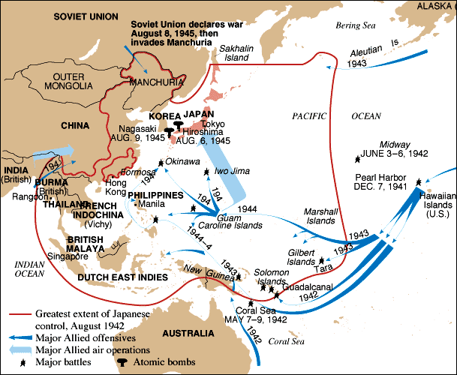
Pacific Theater of Operations

Slide 4
U.S. Struggles
American Navy originally struggled against the Japanese
United States surrenders the Philippines in March of 1942
Evacuates Burma (Myanmar) in 1942
Bataan Death March
Americans win Battle of Midway in June 1942
Turning point in the Pacific War

Slide 5
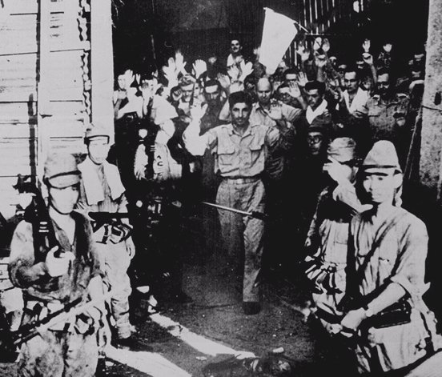
U.S. Surrenders at Corregidor, the Philippines [March, 1942]

Slide 6
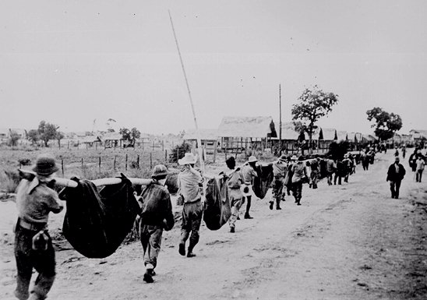
Bataan Death March: April, 1942
76,000 prisoners [12,000 Americans] Marched 60 miles in the blazing heat to POW camps in the Philippines.

Slide 7
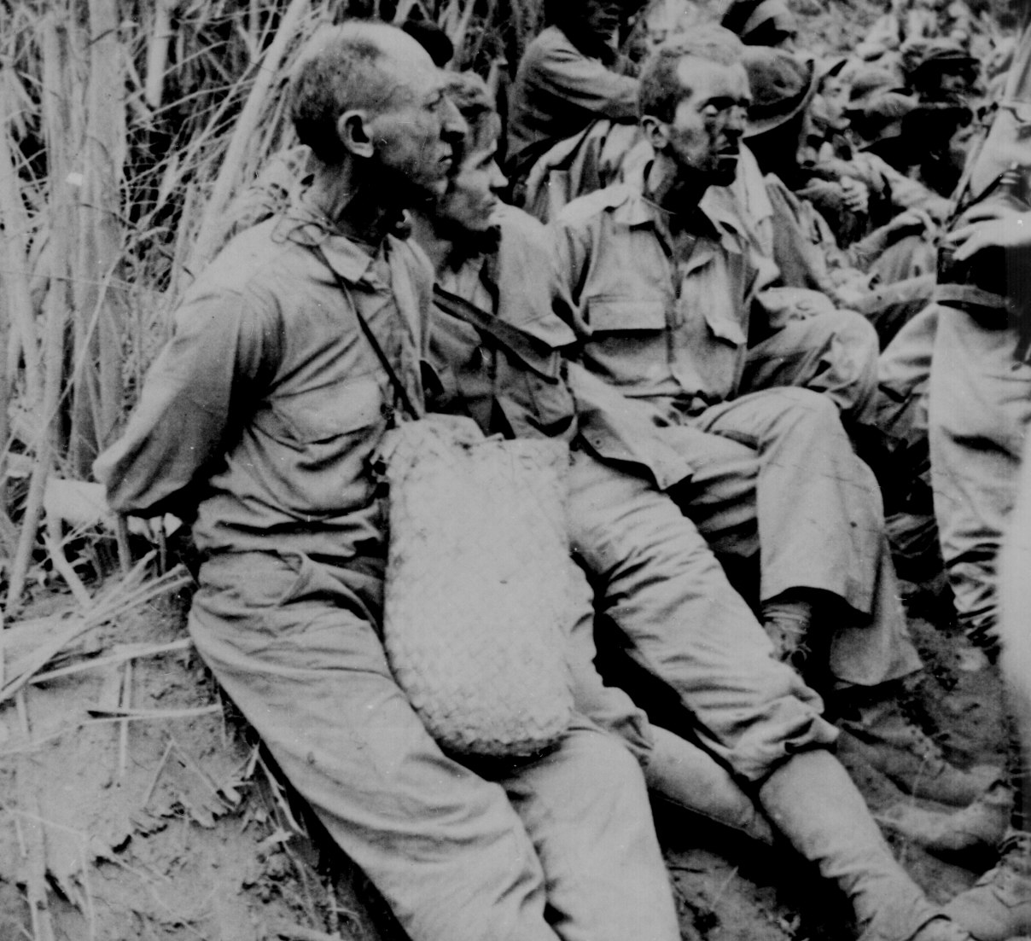
Bataan: British Soldiers
A Liberated British POW

Slide 8
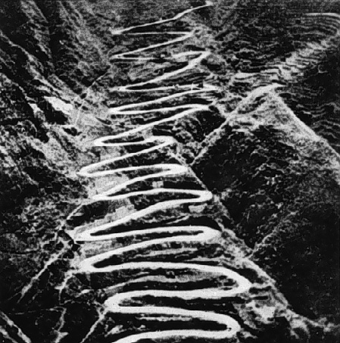
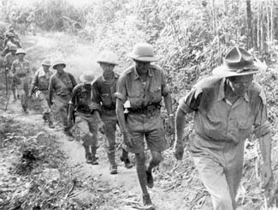
The Burma Campaign
General Stilwell Leaving Burma, 1942
The “Burma Road”

Slide 9
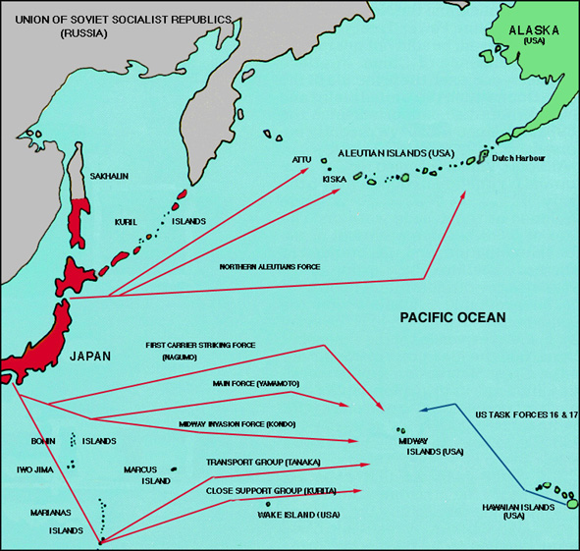
Battle of Midway Island: June 4-6, 1942

Slide 10
Island Hopping
American counter-offensive plan was called “island hopping”
Process of moving from one island to another, taking over that island, and moving on to the next
Long process
Many American casualties

Slide 11
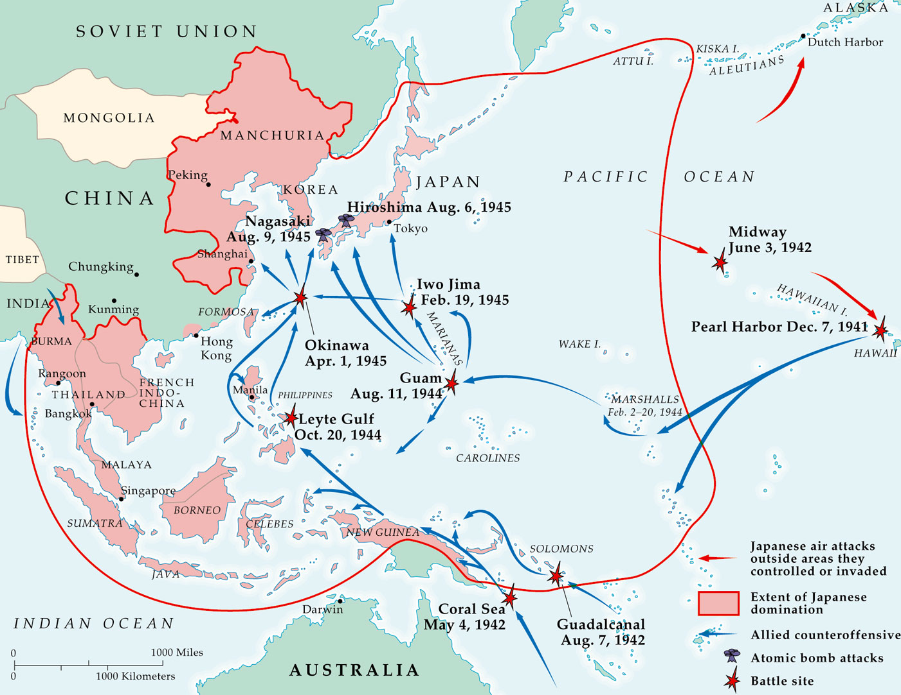
Allied Counter-Offensive: “Island-Hopping”

Slide 12
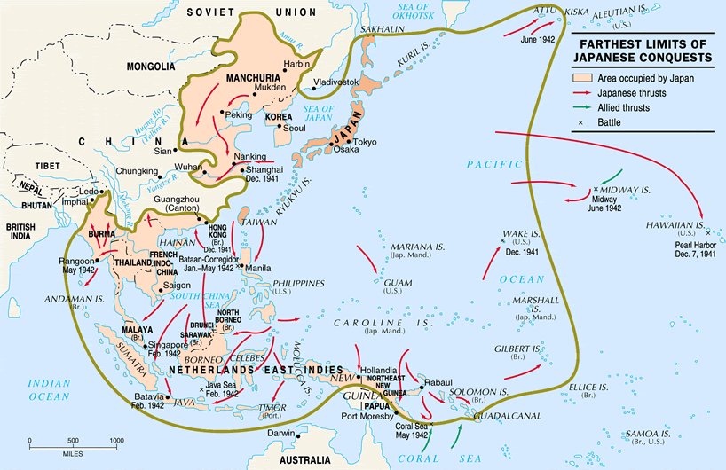
Farthest Extent of Japanese Conquests

Slide 13
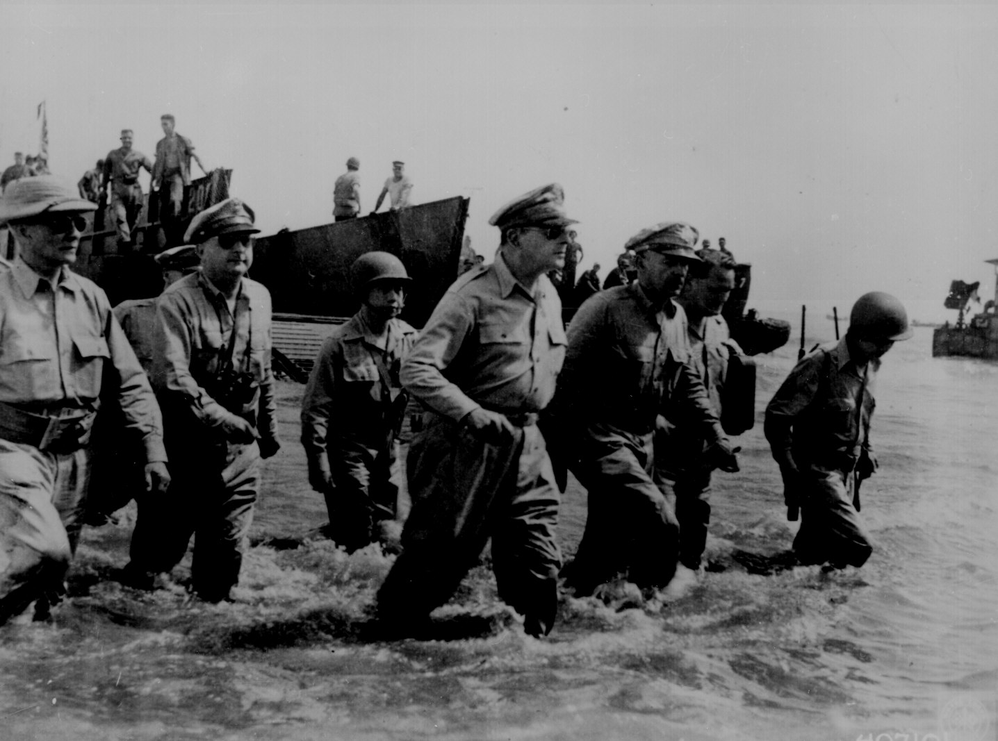
Gen. MacArthur “Returns” to the Philippines! [1944]

Slide 14
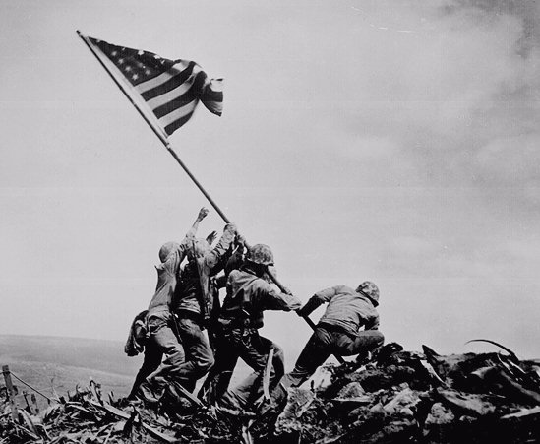
US Marines on Mt. Surbachi, Iwo Jima [Feb. 19, 1945]

Slide 15
Manhattan Project
American project to built an atomic bomb
Led by Robert Oppenheimer
Los Alamos, New Mexico
U.S. will eventually drop atomic bombs on Japan in 1945

Slide 16
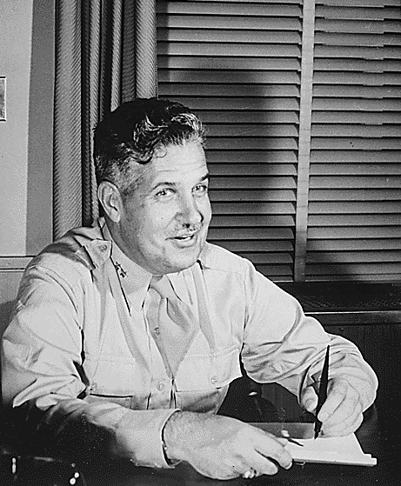
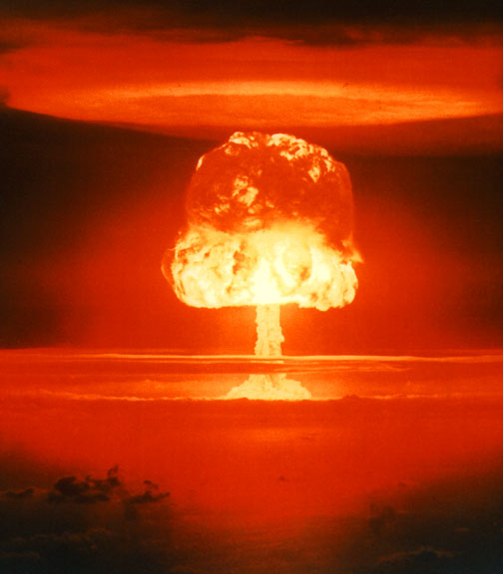
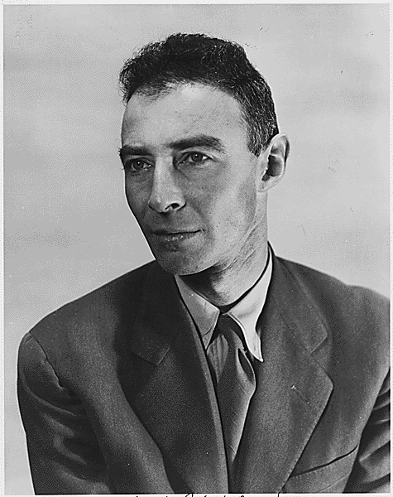
The Manhattan Project: Los Alamos, NM
I have become death, the destroyer of worlds!
Major General Lesley R. Groves
Dr. Robert Oppenheimer

Slide 17
Potsdam Conference
“New Big 3” meet in July of 1945
Discuss the end of the war
Territorial agreements made
War in the Pacific discusses
United States has atomic bomb
Europe is divided into zones of control
Germany divided into East and West

Slide 18
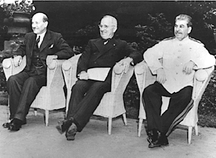
Potsdam Conference: July, 1945
FDR dead, Churchill out of office as Prime Minister during conference.
Stalin only original.
The United States has the A-bomb.
Allies agree Germany is to be divided into occupation zones
Poland moved around to suit the Soviets.
P.M. Clement President Joseph Atlee Truman Stalin

Slide 19
Atomic Bombs
After costly island hopping campaigns
United States drops two atomic bombs on Japan
Approved by President Harry S. Truman
August 6th, 1945 on Hiroshima, Japan
August 9th, 1945 on Nagasaki Japan
Japan surrenders to the United States
Officially ends WWII
V-J Day- September 2nd, 1945

Slide 20
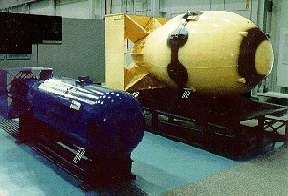
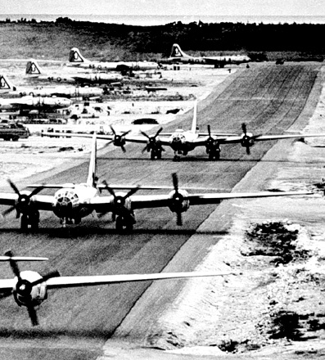
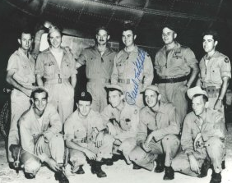
Tinian Island, 1945
Little Boy Fat Man
Enola Gay Crew

Slide 21
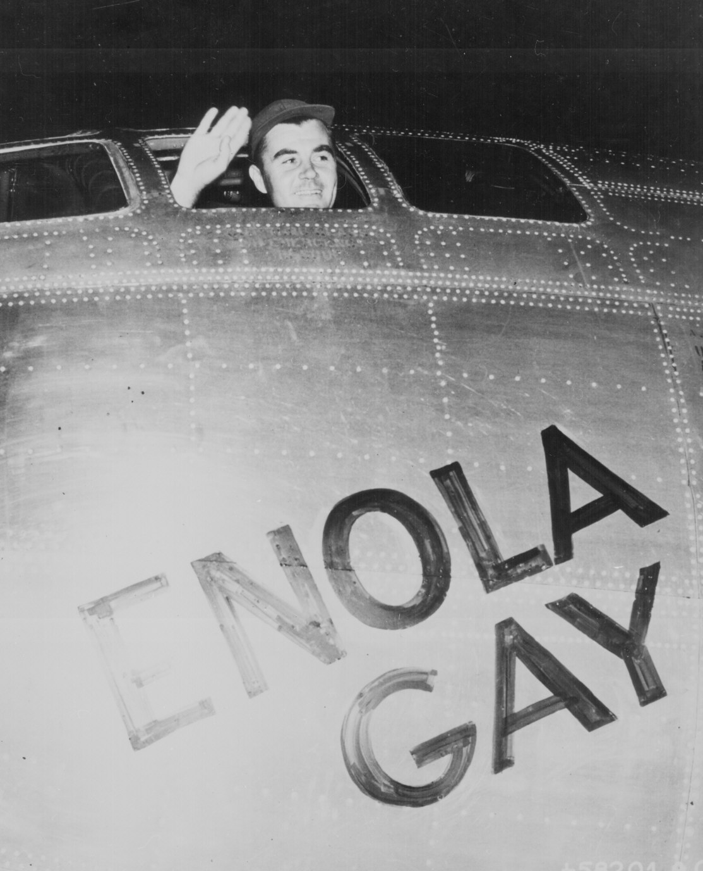
Col. Paul Tibbets & the A-Bomb

Slide 22
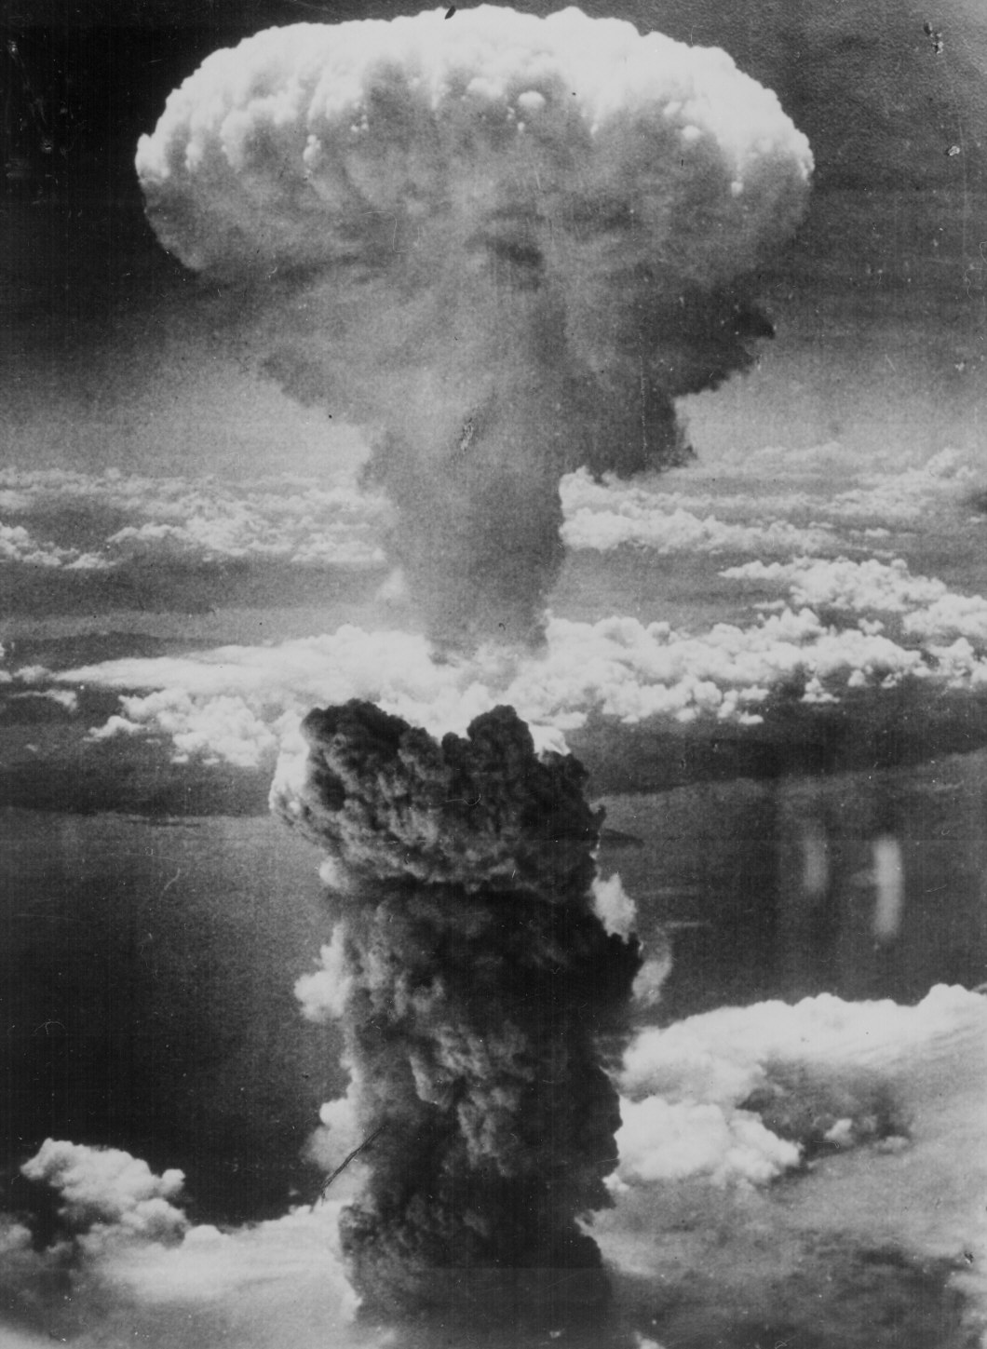
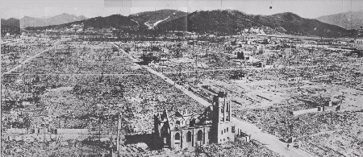
Hiroshima – August 6, 1945
70,000 killed immediately.
48,000 buildings. destroyed.
100,000s died of radiation poisoning & cancer later.

Slide 23
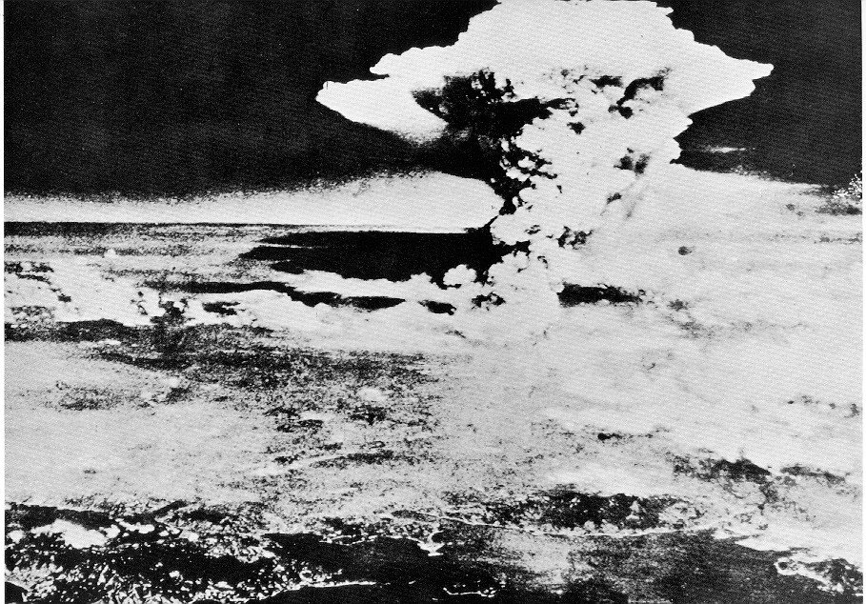
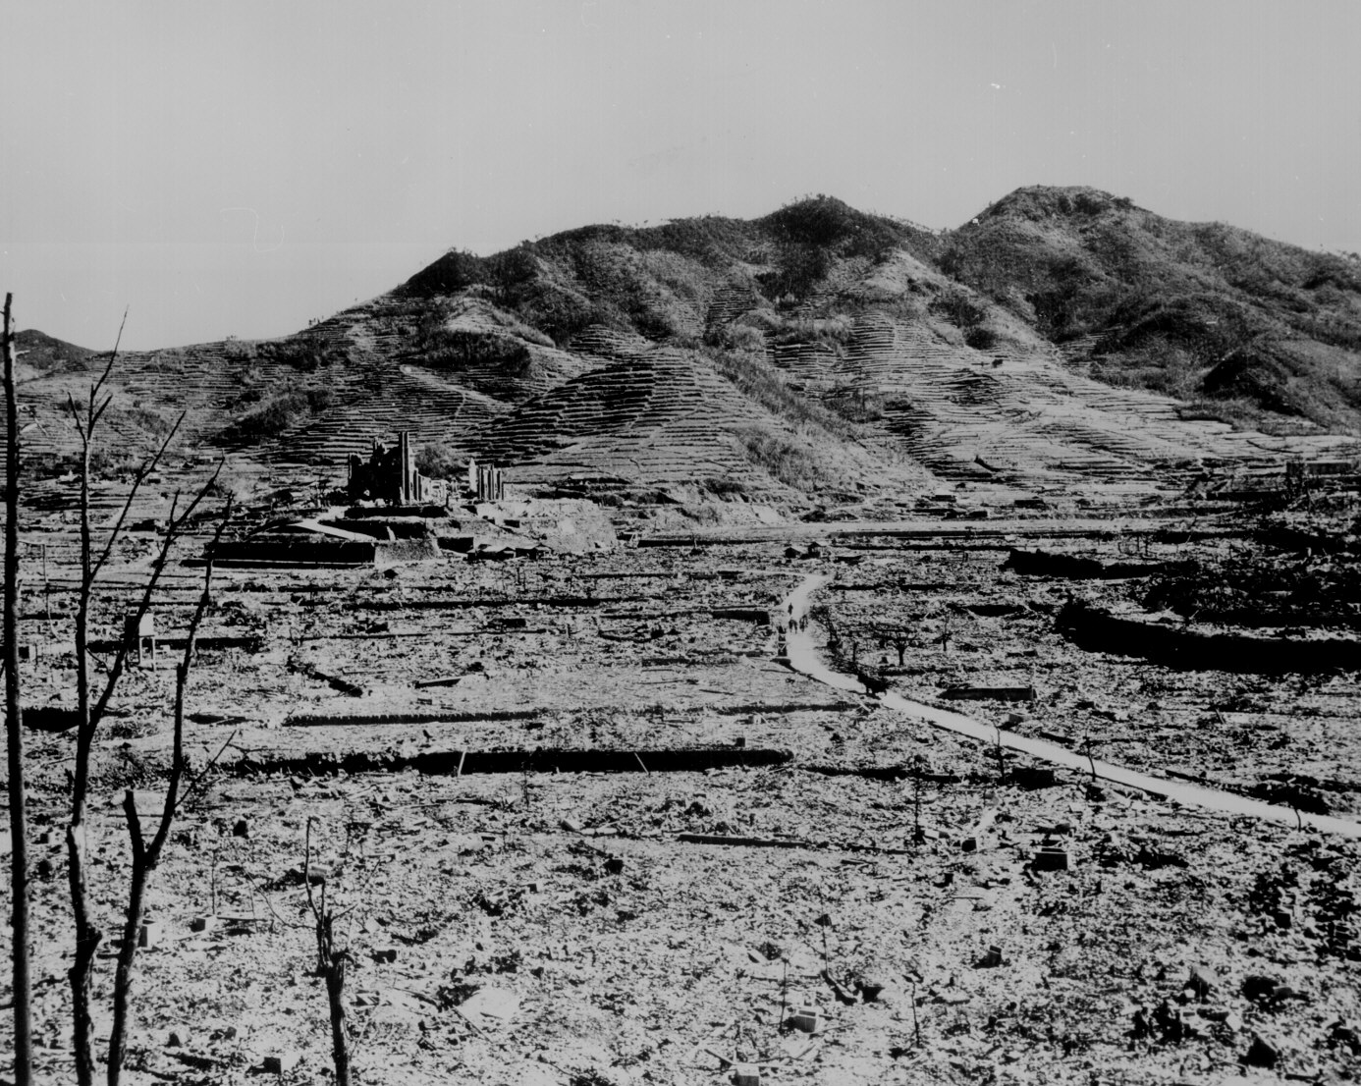
Nagasaki – August 9, 1945
40,000 killed immediately.
60,000 injured.
100,000s died of radiation poisoning & cancer later.

Slide 24
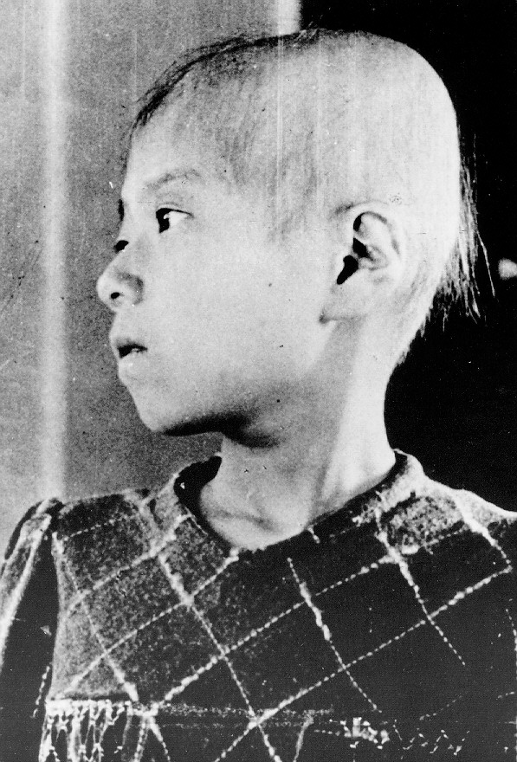
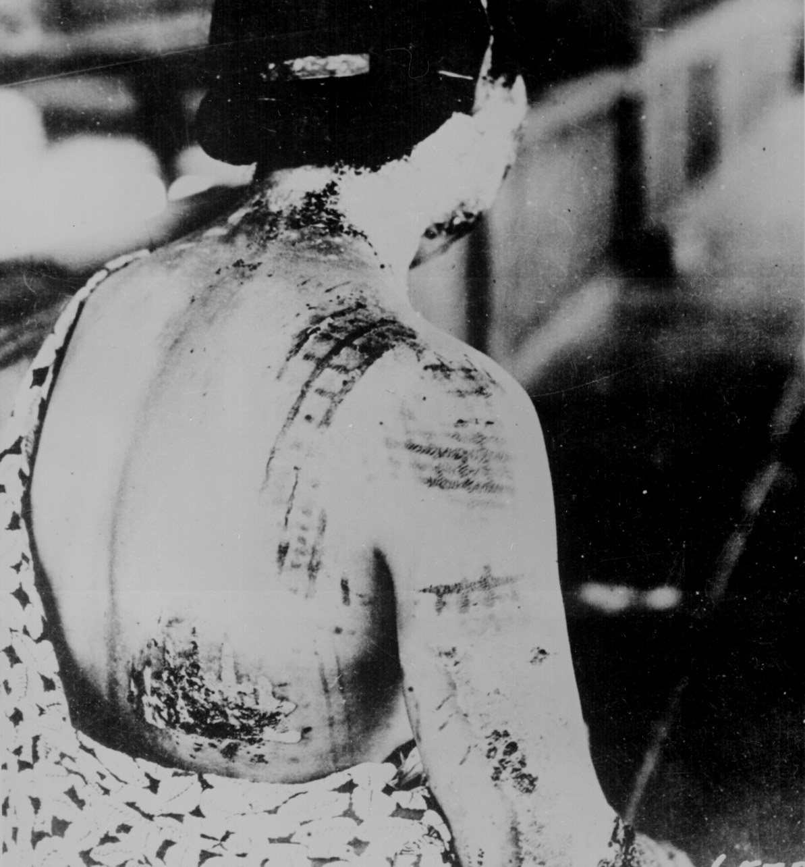
Japanese A-Bomb Survivors

Slide 25
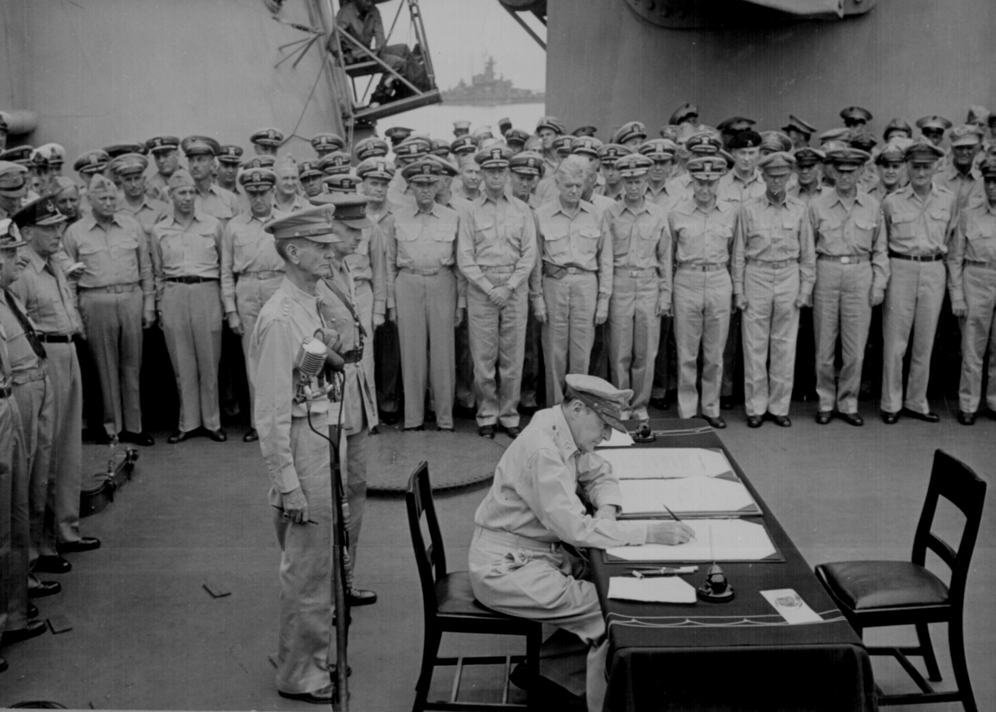
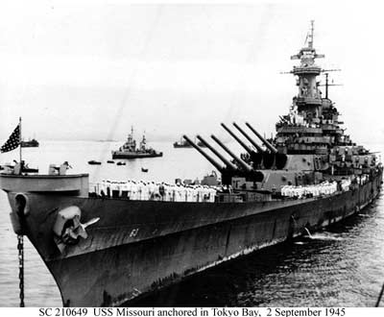
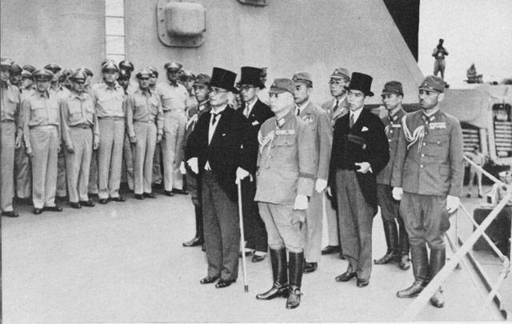
V-J Day (September 2, 1945)

Slide 26
Holocaust

Slide 27
Hitler’s Plan
Hitler’s anti-Semitism belief is unclear
Blamed Jews for Germany’s defeat in WWI
Spoke about a “pure” German race called the “Aryan” race
Planned to persecute Jews and other minorities during WWII
Wanted to populate the world with a “superior race”

Slide 28
Concentration Camps
The first concentration camps open in 1933; Dachau near Munich, Germany
Were first used to hold political enemies of the Nazi Party
Hitler’s obsession with “purification” and “living space” for Germans grew
Planned to imprison “non-pure” races or minorities in concentration camps

Slide 29
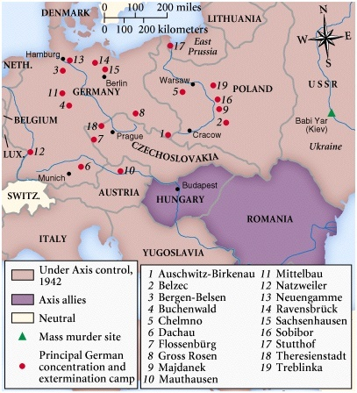
Horrors of the Holocaust Exposed

Slide 30
Jewish Persecution
From 1933 (year Hitler became Chancellor) Jews in Germany began to be persecuted
Nuremberg Laws; laws created to distinguish Jews from non Jews
Allowed for persecution of Jewish people in Germany
Kristallnacht

Slide 31
Kristallnacht
“Night of Broken Glass”
German synagogues were burned
Thousands of Jewish shops and homes had their windows broken
Hundreds of Jews were killed
Thousands arrested
Sent to concentration camps

Slide 32
Poland
In 1939 Germany invaded and occupied Poland
Forced tens of thousands of Jews into Jewish ghettos
High walls
Barbed wire
Gave personal valuables to Germans or Polish citizens that identified as Germans

Slide 33
Euthanasia Program
In 1939 German soldiers selected 70,000 Germans diagnosed with mental illness or mental disabilities
Imprisoned and then gassed to death
Known as the Euthanasia Program
275,000 deemed handicapped or had mental illness were killed by 1945

Slide 34
Germany Expands
By 1941 Hitler had expanded the German empire to control the entire continent of Europe
Transported hundreds of thousands of Jews, homosexuals, Gypsies, and mentally disabled to Poland
As Germany invaded the Soviet Union, mobile killing units would execute over 500,000 Soviet Jews in 1941

Slide 35
Final Solution
Hitler sends memo to top generals to start the “final solution”
Sept. 1941 every person deemed a Jew was forced to wear a yellow star
Thousands began to be executed in gas chambers in Auschwitz, a death camp near Krakow, Poland

Slide 36
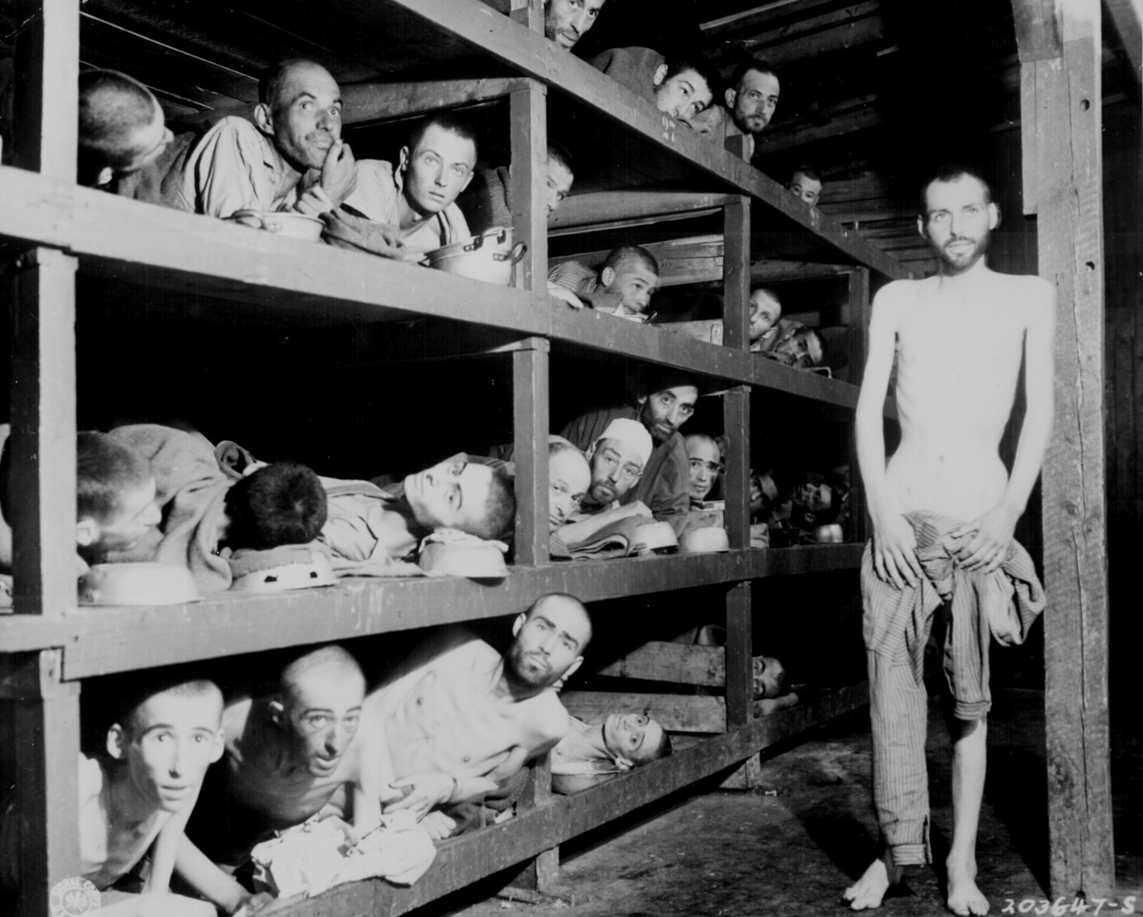
Horrors of the Holocaust Exposed
Eli Wiesel
Slave Labor at Buchenwald

Slide 37
Death Camps
In late 1945 hundreds of thousands of Jews were transported from the Jewish ghettos to death camps
Largest death camp was Auschwitz in Poland
First people deported to camps were weak, elderly, sick, disabled

Slide 38
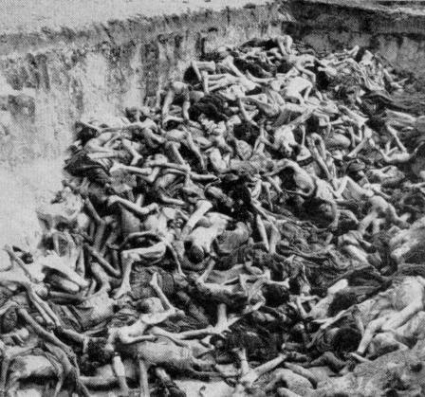
Horrors of the Holocaust Exposed
Mass Graves at Bergen-Belsen

Slide 39
Auschwitz
Largest deportation was to Auschwitz
More than 2 million people were executed at Auschwitz alone
Also made to work hard labor
Hundreds of thousands of others died from starvation or disease
Roughly 12,000 people were killed every day

Slide 40
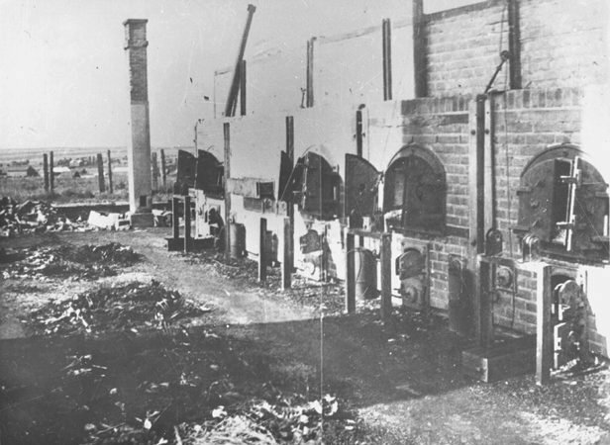
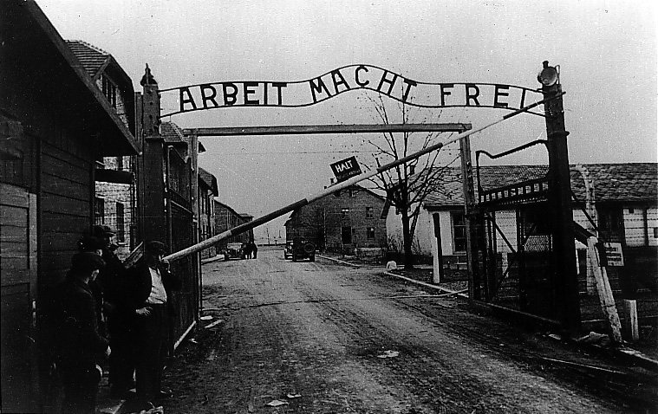
Horrors of the Holocaust Exposed
Entrance to Auschwitz: Work Makes You Free
Crematoria at Majdanek

Slide 41
Impact
Nazis that were not killed during WWII were put on trial at the Nuremburg Trials
Crimes Against Humanity
Pressure to create an independent homeland for Jews
Led to the creation of Israel in 1948
Took land away from Palestine, a British controlled territory

